Slide 1

Functions and Libraries
C H A P T E R 2
Your library is your paradise.
—Desiderius Erasmus, Fisher’s Study at Rotterdam, 1524
2.1 The idea of a function
2.2 Libraries
2.3 Defining functions in C++
2.4 The mechanics of function calls
2.5 Reference parameters
2.6 Interfaces and implementations
2.7 Principles of interface design
2.8 Designing a random number library
2.9 Introduction to the Stanford libraries

Slide 2
The Idea of a Function
Functions are a familiar concept from algebra, where they specify a mathematical calculation based on one or more unknown values, which are called arguments.
As an example, the function
ƒ(x) = x² + 1
specifies that you can calculate the value of the function ƒ by squaring the argument x and then adding 1 to the result. Thus, ƒ(0) is 1, ƒ(1) is 2, ƒ(2) is 5, and so on.
In C++, you can implement a mathematical function by encoding the calculation inside a function definition, like this:
double f(double x) {
return x * x + 1;
}

Slide 3
The Advantages of Using Functions
Functions allow you to shorten a program by allowing you to include the code for a particular operation once and then use it as often as you want in a variety of different contexts, typically with different arguments.
Functions make programs easier to read by allowing you to invoke an entire sequence of operations using a single name that corresponds to a higher-level understanding of the purpose of the function.
Functions simplify program maintenance by allowing you to divide a large program into smaller, more manageable pieces. This process is called decomposition.

Slide 4
Functions and Algorithms
Functions are critical to programming because they provide a structure in which to express algorithms.
Algorithms for solving a particular problem can vary widely in their efficiency. It makes sense to think carefully when you are choosing an algorithm because making a bad choice can be extremely costly.
The next few slides illustrate this principle by implementing two algorithms for computing the greatest common divisor of the integers x and y, which is defined to be the largest integer that divides evenly into both.

Slide 5
The Brute-Force Approach
One strategy for computing the greatest common divisor is to count backwards from the smaller value until you find one that divides evenly into both. The code looks like this:
int gcd(int x, int y) {
int guess = x;
while (x % guess != 0 || y % guess != 0) {
guess--;
}
return guess;
}
This algorithm must terminate for positive values of x and y because the value of guess will eventually reach 1. At that point, guess must be the greatest common divisor because the while loop will have already tested all larger ones.
Trying every possibility is called a brute-force strategy.

Slide 6
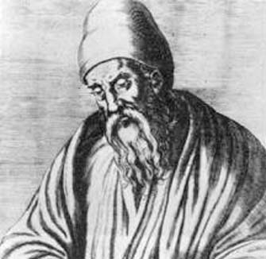
Euclid’s Algorithm
If you use the brute-force approach to compute the greatest common divisor of 1000005 and 1000000, the program will take a million steps to tell you the answer is 5.
You can get the answer much more quickly if you use a better algorithm. The Greek mathematician Euclid of Alexandria described a more efficient algorithm 23 centuries ago, which looks like this:
int gcd(int x, int y) {
int r = x % y;
while (r != 0) {
x = y;
y = r;
r = x % y;
}
return y;
}

Slide 7
How Euclid’s Algorithm Works
If you use Euclid’s algorithm on 1000005 and 1000000, you get the correct answer in just two steps, which is much better than the million steps required by brute force.
Euclid’s great insight was that the greatest common divisor of x and y must also be the greatest common divisor of y and the remainder of x divided by y. He was, moreover, able to prove this proposition in Book VII of his Elements.
It is easy to see how Euclid’s algorithm works if you think about the problem geometrically, as Euclid did. The next slide works through the steps in the calculation when x is 78 and y is 33.

Slide 8
An Illustration of Euclid’s Algorithm
Step 1: Compute the remainder of 78 divided by 33:
x
78
y
33
33
12
Step 2: Compute the remainder of 33 divided by 12:
x
33
y
12
12
9
Step 3: Compute the remainder of 12 divided by 9:
x
12
y
9
3
Step 4: Compute the remainder of 9 divided by 3:
x
9
y
3
3
3
Because there is no remainder, the answer is 3:

Slide 9

Libraries
Modern programming depends on the use of libraries. When you create a typical application, you write only a tiny fraction of the code.
Libraries can be viewed from two perspectives. Code that uses a library is called a client. The code for the library itself is called the implementation.
The point at which the client and the implementation meet is called the interface, which serves as both a barrier and a communication channel:
client
implementation
interface

Slide 10
Useful Functions in the <cmath> Library
abs(x)
Returns the absolute value of x.
sqrt(x)
Returns the square root of x.
floor(x)
Returns the largest integer less than or equal to x.
ceil(x)
Returns the smallest integer greater than or equal to x.
exp(x)
Returns the exponential function of x (e ^{x}).
log(x)
Returns the natural logarithm (base e) of x.
log10(x)
Returns the common logarithm (base 10) of x.
pow(x, y)
Returns x ^{y}.
cos(theta)
Returns the trigonometric cosine of the radian angle theta.
sin(theta)
Returns the sine of the radian angle theta.
tan(theta)
Returns the tangent of the radian angle theta.
atan(x)
Returns the principal arctangent of x.
atan2(y, x)
Returns the arctangent of y divided by x.

Slide 11
Defining Functions in C++
The general form of a function definition in C++ looks much the same as it does in other languages derived from C, such as Java:
type name(parameter list) {
statements in the function body
}
where type indicates what type the function returns, name is the name of the function, and parameter list is a list of variable declarations used to hold the values of each argument.
All functions need to be declared before they are called by specifying a prototype consisting of the header line followed by a semicolon.

Slide 12
C++ Enhancements to Functions
Functions can be overloaded, which means that you can define several different functions with the same name as long as the correct version can be determined by looking at the number and types of the arguments. The pattern of arguments required for a particular function is called its signature.
Functions can specify optional parameters by including an initializer after the variable name. For example, the function prototype
void setMargin(int margin = 72);
Indicates that setMargin takes an optional argument that defaults to 72.

Slide 13
Computing Factorials
The factorial of a number n (which is usually written as n! in mathematics) is defined to be the product of the integers from 1 up to n. Thus, 5! is equal to 120, which is 1 ^{x} 2 ^{x} 3 ^{x} 4 ^{x} 5.
The following function definition uses a for loop to compute the factorial function:
int fact(int n) {
int result = 1;
for (int i = 1; i <= n; i++) {
result *= i;
}
return result;
}

Slide 14
The Mechanics of Calling a Function
When you invoke a function, the following actions occur:
1.
C++ evaluates the argument expressions in the context of the calling function.
2.
C++ then copies each argument value into the corresponding parameter variable, which is allocated in a newly assigned region of memory called a stack frame. This assignment follows the order in which the arguments appear: the first argument is copied into the first parameter variable, and so on.
3.
C++ then evaluates the statements in the function body, using the new stack frame to look up the values of local variables.
4.
When C++ encounters a return statement, it computes the return value and substitutes that value in place of the call.
5.
C++ then discards the stack frame for the called function and returns to the caller, continuing from where it left off.

Slide 15
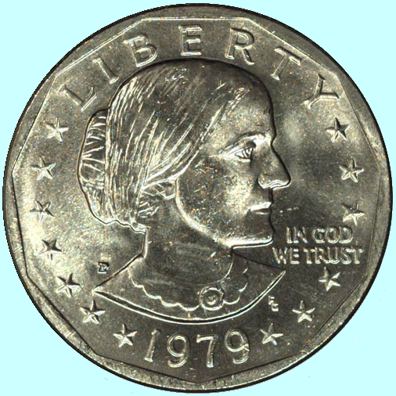
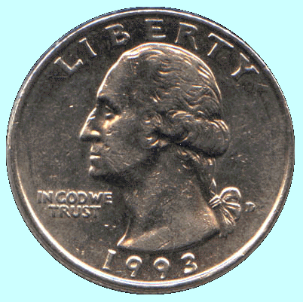
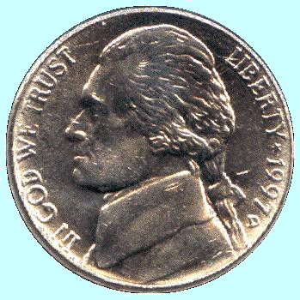
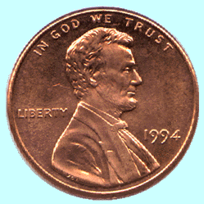
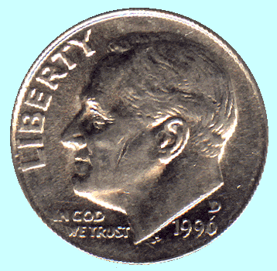
The Combinations Function
To illustrate function calls, the text uses a function C(n, k) that computes the combinations function, which is the number of ways one can select k elements from a set of n objects.
Suppose, for example, that you have a set of five coins: a penny, a nickel, a dime, a quarter, and a dollar:
How many ways are there to select two coins?
penny + nickel
nickel + dime
dime + quarter
quarter + dollar
penny + dime
nickel + quarter
dime + dollar
penny + quarter
nickel + dollar
penny + dollar
for a total of 10 ways.

Slide 16
Combinations and Factorials
Fortunately, mathematics provides an easier way to compute the combinations function than by counting all the ways. The value of the combinations function is given by the formula
n !
C(n, k) =
k !
x
(n – k) !
Given that you already have a fact function, is easy to turn this formula directly into a C++ function, as follows:
int combinations(int n, int k) {
return fact(n) / (fact(k) * fact(n - k));
}
The next slide simulates the operation of combinations and fact in the context of a simple main function.

Slide 17
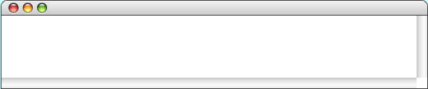
The Combinations Program
int main() {
int n, k;
cout << "Enter the number of objects (n): ";
cin >> n;
cout << "Enter the number to be chosen (k): ";
cin >> k;
cout << "C(n, k) = " << combinations(n, k) << endl;
return 0;
}
int main() {
int n, k;
cout << "Enter the number of objects (n): ";
cin >> n;
cout << "Enter the number to be chosen (k): ";
cin >> k;
cout << "C(n, k) = " << combinations(n, k) << endl;
return 0;
}
int combinations(int n, int k) {
return fact(n) / ( fact(k) * fact(n - k) );
}
int fact(int n) {
int result = 1;
for ( int i = 1 ; i <= n ; i++ ) {
result *= i;
}
return result;
}
int fact(int n) {
int result = 1;
for ( int i = 1 ; i <= n ; i++ ) {
result *= i;
}
return result;
}
int fact(int n) {
int result = 1;
for ( int i = 1 ; i <= n ; i++ ) {
result *= i;
}
return result;
}
120
2
6
n
k
n
n
k
n
n
result
result
result
i
i
10
i
5
2
5
5
2
2
3
120
24
6
6
2
2
2
1
1
1
5
4
4
3
3
3
2
2
2
1
1
1
6
At this point, the program calls the combinations function, as follows:
The program makes another call to fact, with k as its argument.
The program calls fact yet again with n - k as its argument.
The program now calls the fact function, applying the same process.
This call to fact returns the value 2.
The final call to fact returns the value 6.
1. Evaluate the arguments n and k to get the integers 5 and 2.
The fact function returns the value 120 to its caller.
2. Create a new frame for the combinations function.
3. Initialize the parameter variables n and k to the argument values.
Combinations
Enter number of objects in the set (n):
5
Enter number to be chosen (k):
2
C(5, 2) = 10

Slide 18
Reference Parameters
C++ allows callers and functions to share information using a technique known as call by reference.
C++ indicates call by reference by adding an ampersand (&) before the parameter name. A single function often has both value parameters and reference parameters, as illustrated by the solveQuadratic function:
void solveQuadratic(double a, double b, double c,
double & x1, double & x2);
Call by reference has two primary purposes:
It creates a sharing relationship that makes it possible to pass information in both directions through the parameter list.
It increases efficiency by eliminating the need to copy an argument. This consideration becomes more important when the argument is a large object.

Slide 19
Call by Reference Example
The following function swaps the values of two integers:
void swap(int & x, int & y) {
int tmp = x;
x = y;
y = tmp;
}
The arguments to swap must be assignable objects, which for the moment means variables.
If you left out the & characters in the parameter declarations, calling this function would have no effect on the calling arguments because the function would exchange local copies.

Slide 20
Creating Library Interfaces
In C++, libraries are made available to clients through the use of an interface file that has the suffix .h, which designates a header file, as illustrated by the following error.h file:
/*
* File: error.h
* -------------
* This file defines a simple function for reporting errors.
*/
#ifndef _error_h
#define _error_h
/*
* Function: error
* Usage: error(msg);
* ------------------
* Writes the string msg to the cerr stream and then exits the program
* with a standard status code indicating failure.
*/
void error(std::string msg);
#endif
Interfaces require standardized definitions called boilerplate to ensure that the interface file is read only once during a compilation.
All references to standard libraries in header files must include the std:: marker.

Slide 21
Implementing Library Interfaces
In C++, the header file contains only the prototypes of the exported functions. The implementations of those functions appear in the corresponding .cpp file:
/*
* File: error.cpp
* ---------------
* This file implements the error.h interface.
*/
#include <iostream>
#include <cstdlib>
#include <string>
#include "error.h"
using namespace std;
/*
* This function writes out the error message to the cerr stream and
* then exits the program. The EXIT_FAILURE constant is defined in
* <cstdlib> to represent a standard failure code.
*/
void error(string msg) {
cerr << msg << endl;
exit(EXIT_FAILURE);
}
Implementation files typically include their own interface.

Slide 22
Principles of Interface Design
Unified. Every library should define a consistent abstraction with a clear unifying theme. If a function does not fit within that theme, it should not be part of the interface.
Simple. The interface design should simplify things for the client. To the extent that the underlying implementation is itself complex, the interface must seek to hide that complexity.
Sufficient. For clients to adopt a library, it must provide functions that meet their needs. If some critical operation is missing, clients may decide to abandon it and develop their own tools.
Flexible. A well-designed library should be general enough to meet the needs of many different clients. A library that offers narrowly defined operations for one client is not nearly as useful as one that can be used in many different situations.
Stable. The functions defined in a class exported by a library should maintain precisely the same structure and effect, even as the library evolves. Making changes in the behavior of a library forces clients to change their programs, which reduces its utility.

Slide 23
Designing a Random Number Library
Nondeterministic behavior turns out to be difficult to achieve on a computer. A computer executes its instructions in a precise, predictable way. If you give a computer program the same inputs, it will generate the same outputs every time, which is not what you want in a nondeterministic program.
Given that true nondeterminism is so difficult to achieve in a computer, libraries such as the random.h interface described in this chapter must instead simulate randomness by carrying out a deterministic process that satisfies the following criteria:
1.
The values generated by that process should be difficult for human observers to predict.
2.
Those values should appear to be random, in the sense that they should pass statistical tests for randomness.
Because the process is not truly random, the values generated by the random.h interface are said to be pseudorandom.

Slide 24
The random.h Interface
/*
* File: random.h
* --------------
* This file exports functions for generating pseudorandom numbers.
*/
#ifndef _random_h
#define _random_h
/*
* Function: randomInteger
* Usage: int n = randomInteger(low, high);
* ----------------------------------------
* Returns a random integer in the range low to high, inclusive.
*/
int randomInteger(int low, int high);

Slide 25
The random.h Interface
/*
* File: random.h
* --------------
* This file exports functions for generating pseudorandom numbers.
*/
#ifndef _random_h
#define _random_h
/*
* Function: randomInteger
* Usage: int n = randomInteger(low, high);
* ----------------------------------------
* Returns a random integer in the range low to high, inclusive.
*/
int randomInteger(int low, int high);
/*
* Function: randomReal
* Usage: double d = randomReal(low, high);
* ----------------------------------------
* Returns a random number in the half-open interval [low, high).
* A half-open interval includes the first endpoint but not the
* second.
*/
double randomReal(double low, double high);
/*
* Function: randomChance
* Usage: if (randomChance(p)) ...
* -------------------------------
* Returns true with the probability indicated by p. The
* argument p must be a floating-point number between 0 (never)
* and 1 (always).
*/
bool randomChance(double p);

Slide 26
The random.h Interface
/*
* Function: randomReal
* Usage: double d = randomReal(low, high);
* ----------------------------------------
* Returns a random number in the half-open interval [low, high).
* A half-open interval includes the first endpoint but not the
* second.
*/
double randomReal(double low, double high);
/*
* Function: randomChance
* Usage: if (randomChance(p)) ...
* -------------------------------
* Returns true with the probability indicated by p. The
* argument p must be a floating-point number between 0 (never)
* and 1 (always).
*/
bool randomChance(double p);
/*
* Function: setRandomSeed
* Usage: setRandomSeed(seed);
* ---------------------------
* Sets the internal random number seed to the specified value.
* You can use this function to set a specific starting point
* for the pseudorandom sequence or to ensure that program
* behavior is repeatable during the debugging phase.
*/
void setRandomSeed(int seed);
#endif

Slide 27
The random.cpp Implementation
/*
* File: random.cpp
* ----------------
* This file implements the random.h interface.
*/
#include <cstdlib>
#include <cmath>
#include <ctime>
#include "random.h"
#include "private/randompatch.h"
using namespace std;
/* Private function prototype */
static void initRandomSeed();

Slide 28
The random.cpp Implementation
/*
* File: random.cpp
* ----------------
* This file implements the random.h interface.
*/
#include <cstdlib>
#include <cmath>
#include <ctime>
#include "random.h"
#include "private/randompatch.h"
using namespace std;
/* Private function prototype */
static void initRandomSeed();
/*
* Implementation notes: randomInteger
* -----------------------------------
* The code for randomInteger produces the number in four steps:
*
* 1. Generate a random real number d in the range [0 .. 1).
* 2. Scale the number to the range [0 .. N).
* 3. Translate the number so that the range starts at low.
* 4. Truncate the result to the next lower integer.
*
* The implementation is complicated by the fact that both the
* expression RAND_MAX + 1 and the expression high - low + 1 can
* overflow the integer range.
*/
int randomInteger(int low, int high) {
initRandomSeed();
double d = rand() / (double(RAND_MAX) + 1);
double s = d * (double(high) - low + 1);
return int(floor(low + s));
}

Slide 29
The random.cpp Implementation
/*
* Implementation notes: randomInteger
* -----------------------------------
* The code for randomInteger produces the number in four steps:
*
* 1. Generate a random real number d in the range [0 .. 1).
* 2. Scale the number to the range [0 .. N).
* 3. Translate the number so that the range starts at low.
* 4. Truncate the result to the next lower integer.
*
* The implementation is complicated by the fact that both the
* expression RAND_MAX + 1 and the expression high - low + 1 can
* overflow the integer range.
*/
int randomInteger(int low, int high) {
initRandomSeed();
double d = rand() / (double(RAND_MAX) + 1);
double s = d * (double(high) - low + 1);
return int(floor(low + s));
}
/*
* Implementation notes: randomReal
* --------------------------------
* The code for randomReal is similar to that for randomInteger,
* without the final conversion step.
*/
double randomReal(double low, double high) {
initRandomSeed();
double d = rand() / (double(RAND_MAX) + 1);
double s = d * (high - low);
return low + s;
}

Slide 30
The random.cpp Implementation
/*
* Implementation notes: randomReal
* --------------------------------
* The code for randomReal is similar to that for randomInteger,
* without the final conversion step.
*/
double randomReal(double low, double high) {
initRandomSeed();
double d = rand() / (double(RAND_MAX) + 1);
double s = d * (high - low);
return low + s;
}
/*
* Implementation notes: randomChance
* ----------------------------------
* The code for randomChance calls randomReal(0, 1) and then checks
* whether the result is less than the requested probability.
*/
bool randomChance(double p) {
initRandomSeed();
return randomReal(0, 1) < p;
}

Slide 31
The random.cpp Implementation
/*
* Implementation notes: randomChance
* ----------------------------------
* The code for randomChance calls randomReal(0, 1) and then checks
* whether the result is less than the requested probability.
*/
bool randomChance(double p) {
initRandomSeed();
return randomReal(0, 1) < p;
}
/*
* Implementation notes: setRandomSeed
* -----------------------------------
* The setRandomSeed function simply forwards its argument to
* srand. The call to initRandomSeed is required to set the
* initialized flag.
*/
void setRandomSeed(int seed) {
initRandomSeed();
srand(seed);
}

Slide 32
The random.cpp Implementation
/*
* Implementation notes: setRandomSeed
* -----------------------------------
* The setRandomSeed function simply forwards its argument to
* srand. The call to initRandomSeed is required to set the
* initialized flag.
*/
void setRandomSeed(int seed) {
initRandomSeed();
srand(seed);
}
/*
* Implementation notes: initRandomSeed
* ------------------------------------
* The initRandomSeed function declares a static variable that
* keeps track of whether the seed has been initialized. The
* first time initRandomSeed is called, initialized is false,
* so the seed is set to the current time.
*/
static void initRandomSeed() {
static bool initialized = false;
if (!initialized) {
srand(int(time(NULL)));
initialized = true;
}
}

Slide 33
Introduction to the Stanford Libraries
Programming Abstractions in C++ comes with a variety of library packages developed at Stanford to make it easier for students to learn the underlying concepts. These libraries include the following:
console.h
Redirects standard input and output to a console window.
error.h
Supports error reporting and recovery.
graphics.h
Implements a simple, portable, object-oriented graphical model.
simpio.h
Suoports improved error-checking for input operations.
strlib.h
Extends the set of string operations.
You can learn more about these libraries from the tables of functions in the textbook, from the web-based documentation, or by reading the interfaces.

Slide 34
The End

